Slide 1
Water quality analysis
Aayush Shah
Harsh Mistry

Slide 2
Contents
Introduction​
Dataset
Visualization
​Result
Conclusion

Slide 3
Introduction
Access to drinking water is one of the fundamental human rights. Many factors affect water quality, it is also one of the major research areas in data science.The quality of water cannot be analysed on basis of a single factor. It includes many factors like pH,Hardness,Turbidity,etc.
The goal here is to determine the range of values of the factors such that the water is drinkable/portable.

Slide 4
Dataset
Understanding the dataset

Slide 5
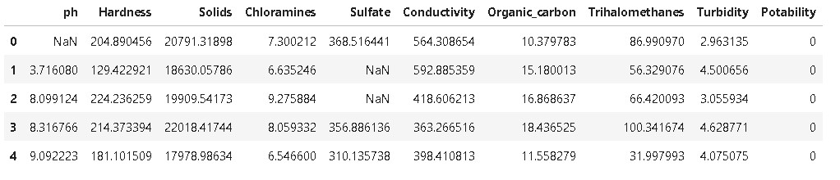
Glance of dataset
The dataset consists of 3277 rows of data which is the data from random water bodies around India.
The dataset consists of data of various factors that affects the portability of water such as pH,Hardness,Solids,
Chloramines,etc.
The last column consists of the Portability data.If the value is 0 then it means that the water is not portable or
drinkable and conversely if the value is 1 then it is drinkable.

Slide 6
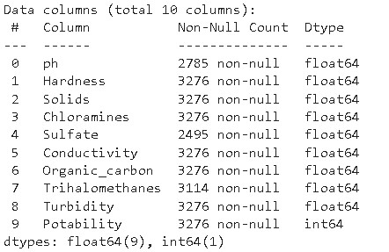
Working with null values
While working with raw data we may often encounter null values which can be a major obstacle in the
analysis. Here by using df.info() we get all the info of the non-null values that are in the dataset. Here we
can see that out of 3277 values of pH, only 2785 are non-null. These non-null values must be dealt with
before moving on.

Slide 7
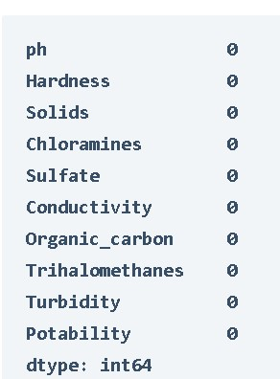
Dealing with null values
All the row that contains NULL values are deleted using the dropna() function of Pandas. This way we can get
a dataset that we can work on effectively.Now just to make sure there are no null values left we use isnull().sum()
function and we get the output as above figure. As all the sum results are 0 we can say that there are no NULL
values left in the dataset.

Slide 8
visualization
Using the ploting libraries for visualizing data

Slide 9
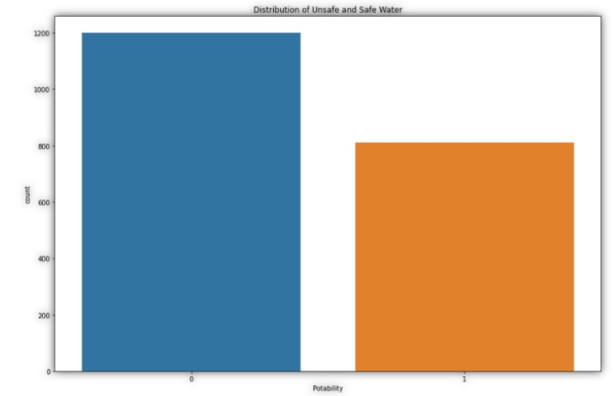
Distribution of the portability
Portability is the factor that determines if the water is drinkable or not. The figure shows the distribution of the
Portability where 0 means not drinkable and 1 means drinkable. For this distribution plot seaborn library is used
which is built upon matplotlib and is mainly used for distribution plots. We can see that portable water is less than
unfit water in the data.

Slide 10
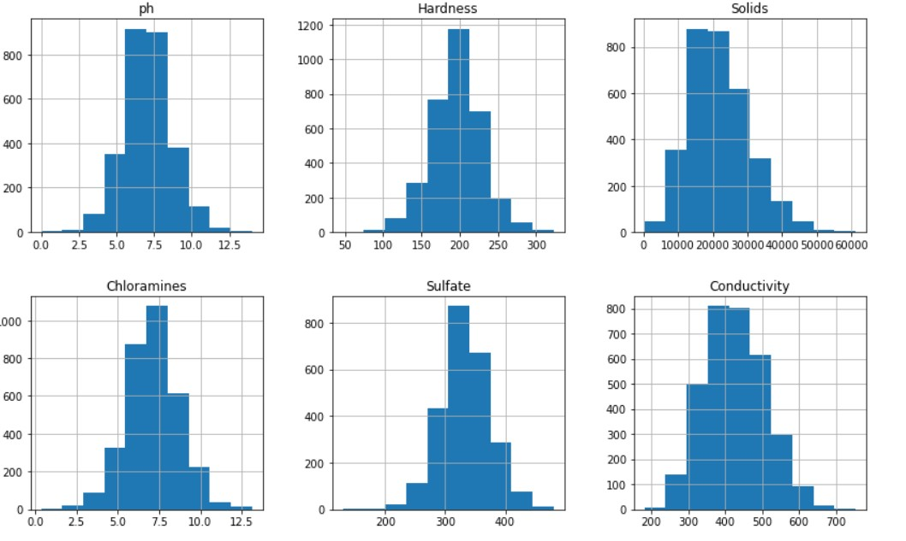
Histograms depicting the range of distribution of factors

Slide 11
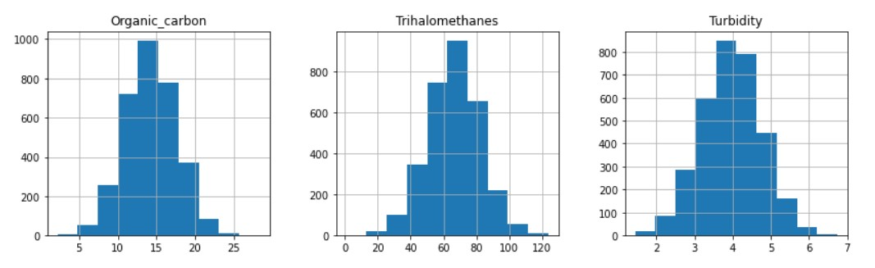
Histograms depicting the range of distribution of factors
These histograms for all the factors that affect the portability determines the range of distribution of
each one that is given in dataset. For example we can see that for pH there are maximum values in the
Range 5.5-8 . We can understand the distribution here but cannot determine their relation to the
portability. (These are plotted by Matplotlib library)

Slide 12
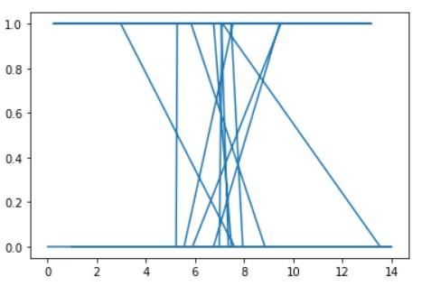
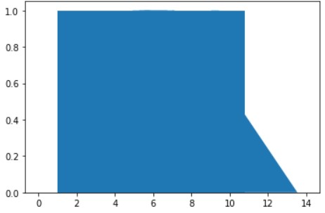
Result cannot be obtained by observing only one factor
The graph on left side is the line chart of portability v/s pH. We can observer a weird and uneven line pattern.
Similarly the stackplot of portability v/s pH also gives uneven plot. Thus, we can determine that we cannot
derive the result by observing only one factor.

Slide 13
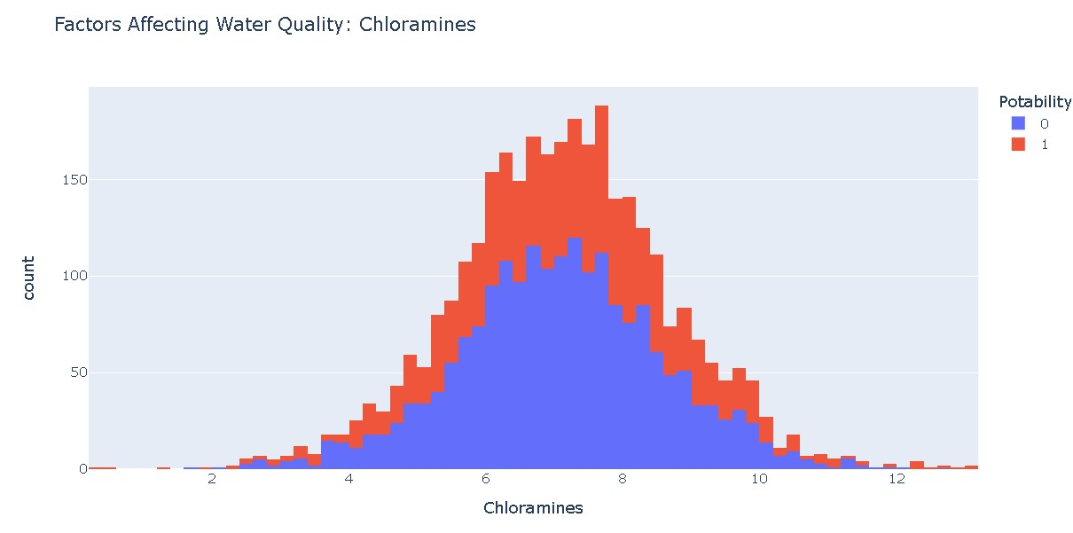
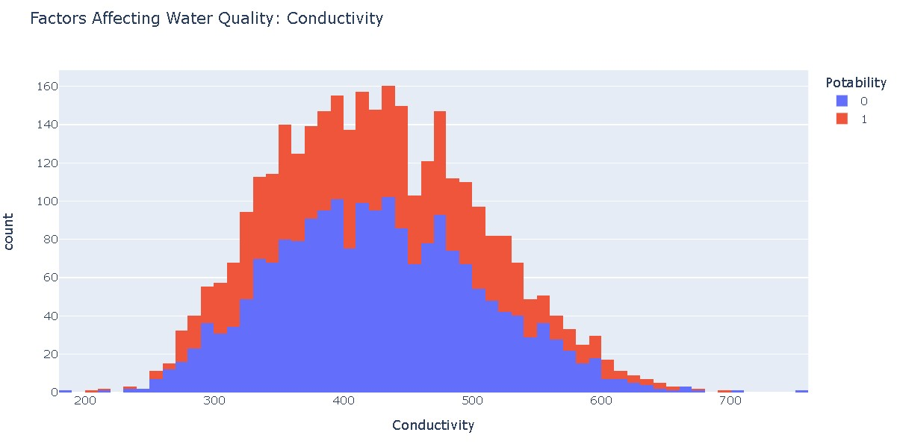
Plotling histograms for different values of Portability

Slide 14
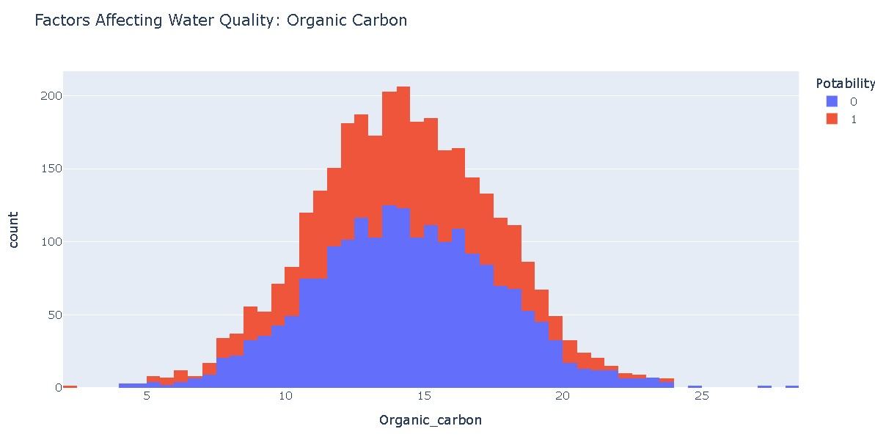
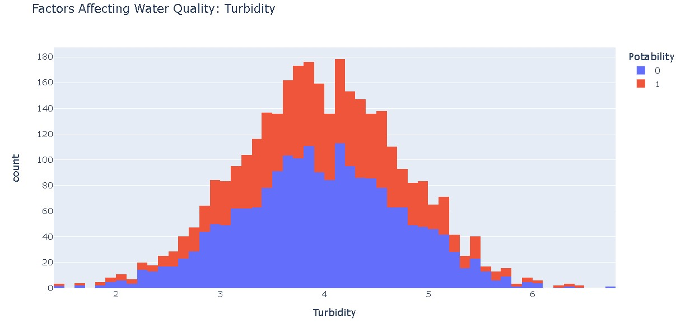
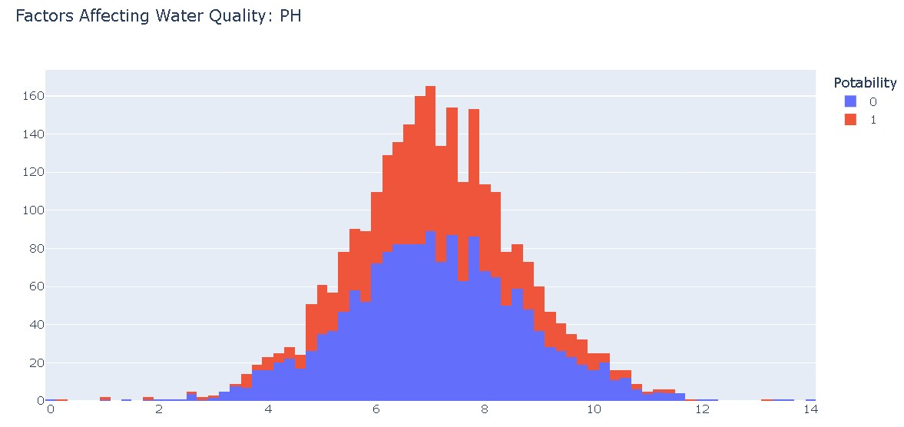

Slide 15
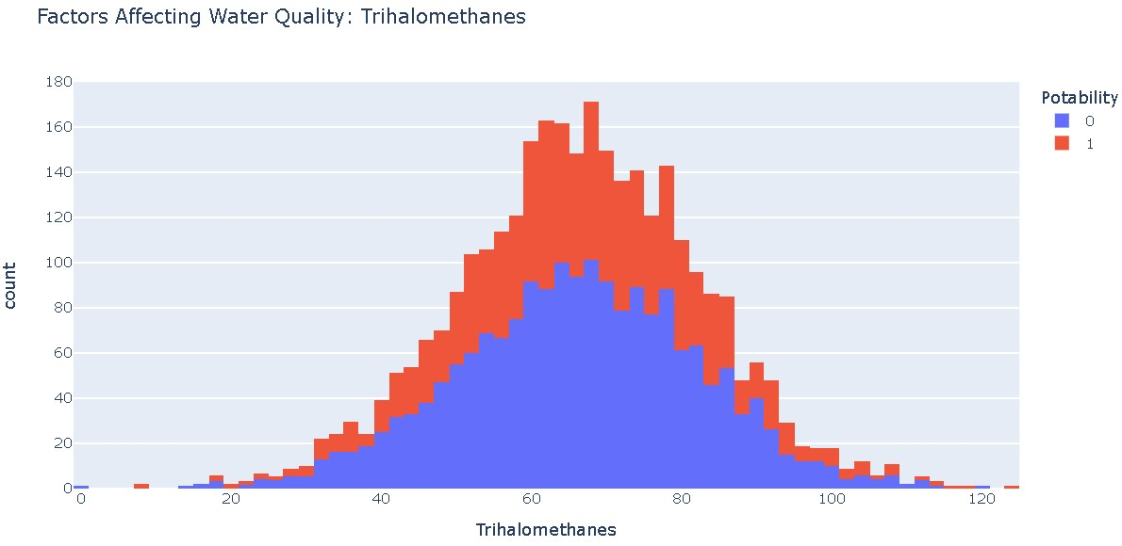
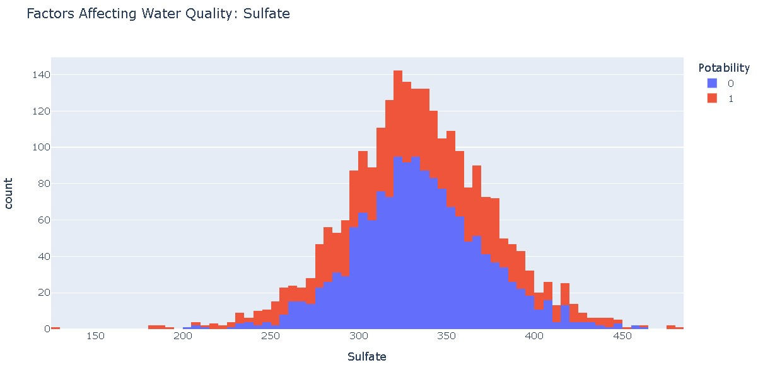
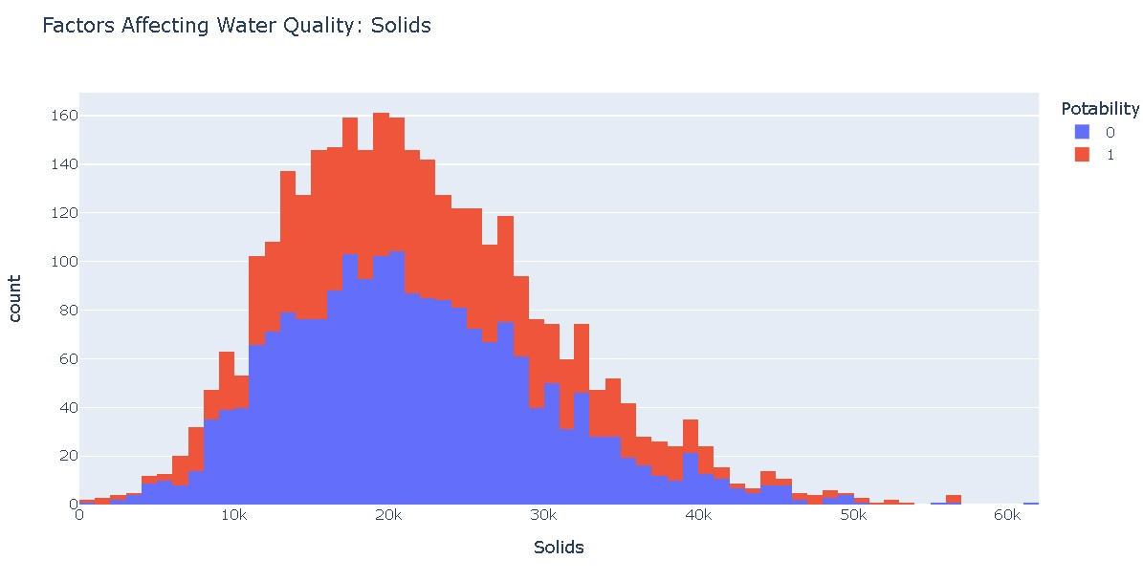

Slide 16
result
By observing the plots and comparing the values with portability values(just by visualization) we can derive:
pH value of drinking water should be between 6.5 and 7.9 .
Hardness of 160-200 milligrams is drinkable.
Chloramine quantity between 6 - 8 is portable.
Turbidity should be between 3.5 - 4.3 .
Solids quantity between 15k – 23k is portable.
Sulfate quantity 300-355 is portable.
Water with an electrical conductivity of less than 500 is drinkable.
Water containing less than 25 milligrams of organic carbon is considered safe to drink.
Water containing less than 80 milligrams of THMs is considered safe to drink.

Slide 17
conclusion
Thus, by collecting dataset and refining it , then using various visualization libraries for generating graphs and charts we can compare and derive the values or range of values of the factors affecting the water quality.
Libraries use for manipulating data: Numpy,Pandas
Libraries used for visualization: Matplotlib, Seaborn, Plotly.express

Slide 18
THANK YOU
Github repository link: https://github.com/AayushShah18/Water-Quality

